Slide 1
Know Your Role: Building in Accessibility Throughout Your Projects' Lifecycle
Angela M. Hooker
#RoleBasedA11y @AccessForAll
#PSUweb2013 angelahooker.com

Slide 2
Hello!
Angela Hooker
@AccessForAll
#RoleBasedA11y
SlideShare
ange@angelahooker.com
angelahooker.com

Slide 3
What part of a project phase is the most challenging, accessibility-wise, for you?
Notes:
Think about this, and we’ll address your answers later.

Slide 4
I work with a great web team!
Notes:
Let me introduce you to them …

Slide 5
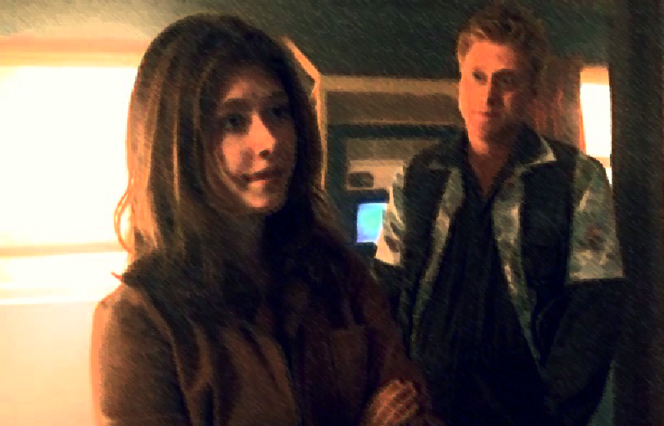
These are the back end developers.

Slide 6
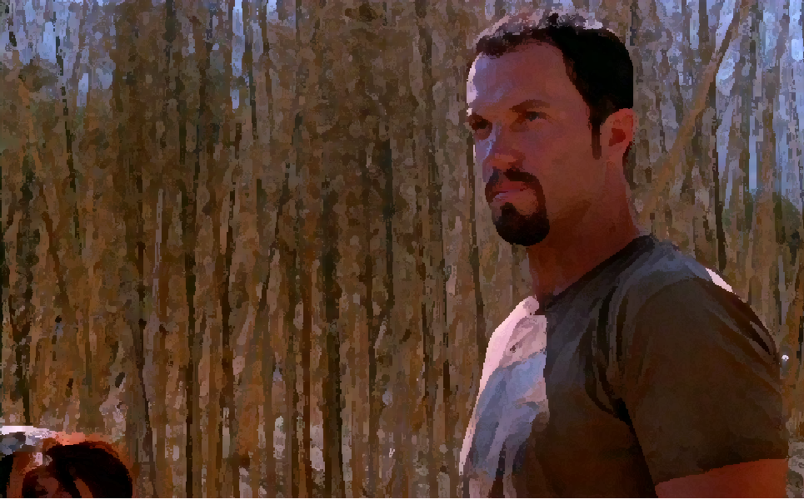
This is our front end developer.

Slide 7
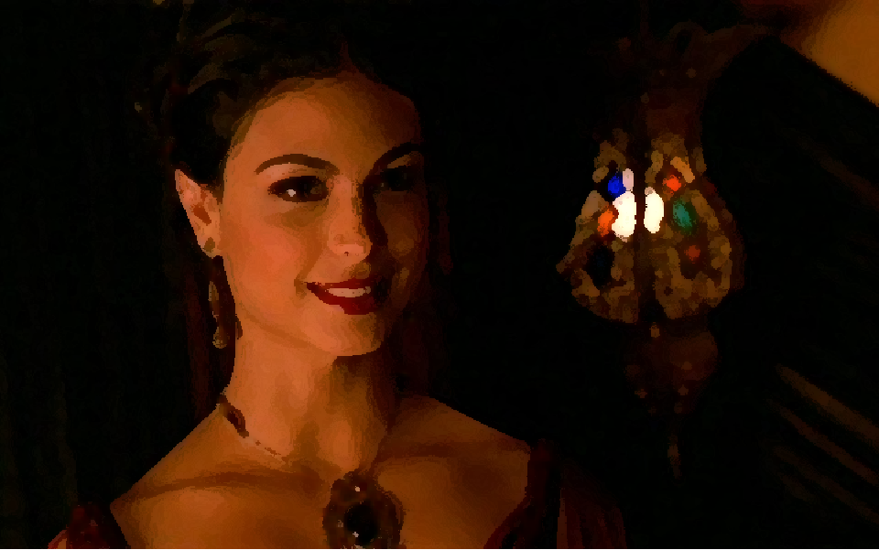
This is our designer.

Slide 8
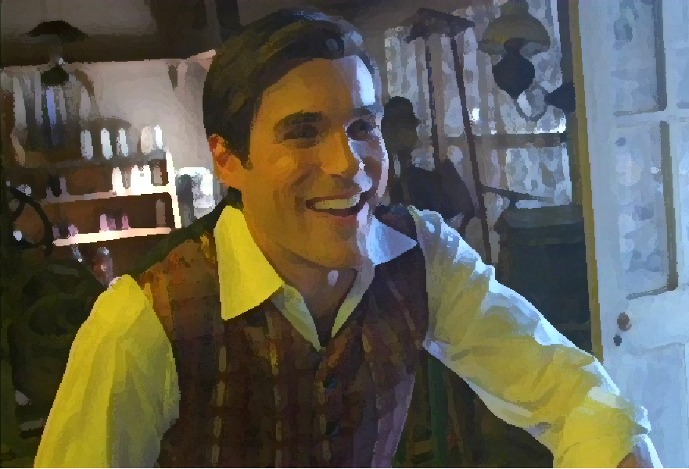
This is our usability specialist.

Slide 9
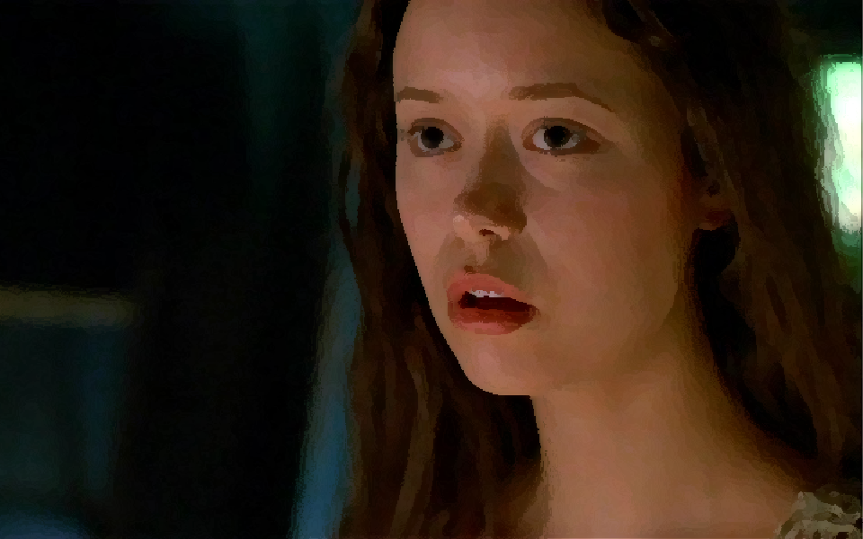
This is our content lead.
Notes:
Okay, she’s a bit high strung, but she writes some profound things every once in a while.

Slide 10
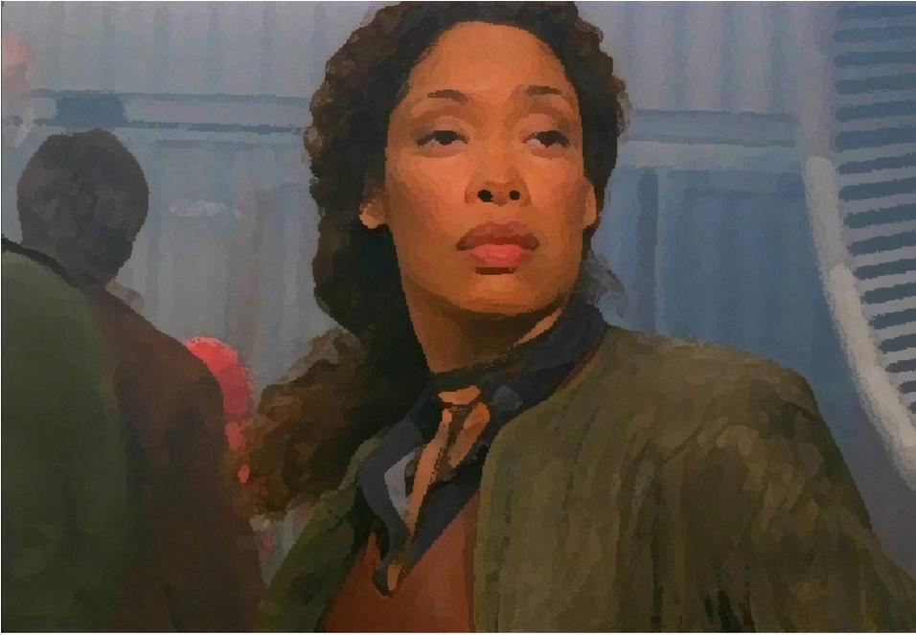
This is our project manager.

Slide 11
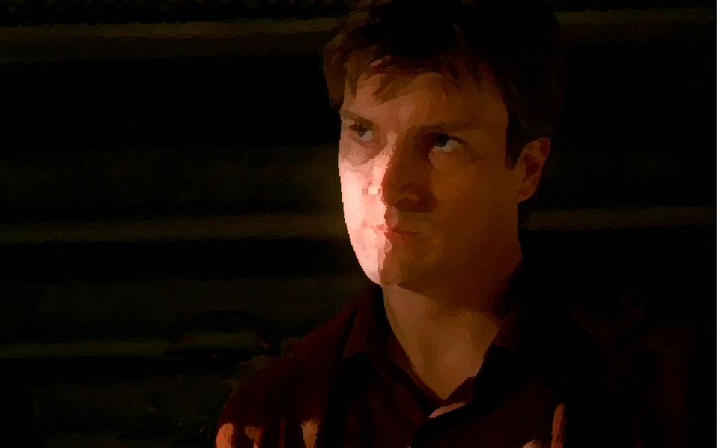
This is our senior manager/director.

Slide 12
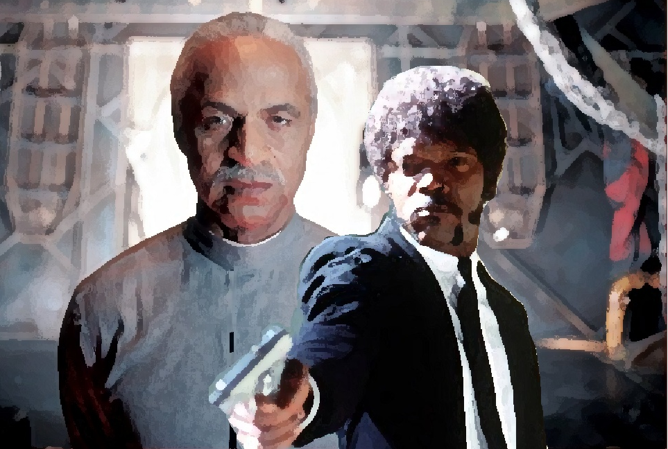
And this is me …
Notes:
I’m always “trying … to be the shepherd,” but I have a multi-faceted personality at work—part Jules, part Shepherd Book.

Slide 13
My job began as an open-ended position

Slide 14
My job
Ensure we’re following the best practices in our design, development, and content.
Ensure we’re following all laws and requirements.
Teach best practices.
Scope is for our main websites and all other new media products and projects.

Slide 15
I am our team’s shepherd on the web.

Slide 16
I had to create a process.
Notes:
Then … I started. I read code, analyzed our design, and read all our content. I had to get a process in order—at that time, we updated our sites twice a week. This was before we had a CMS—less than 100 pages.

Slide 17
Success!
Notes:
And we were all happy and in love!

Slide 18
… but we grew too much, too fast, which meant compromises.
Notes:
I hate compromising on accessibility—who wins? If were doing things right in the first place, we didn’t have to compromise.

Slide 19
We ended up with products that were inaccessible.

Slide 20
Despite our best intentions, we never went back to fix things.
Notes:
Suddenly, we had several main sites, micro sites, software, and so on …

Slide 21
Wait a minute!
Notes:
And I told them, "Nobody should start any project without putting me in the project team!" And they listened. Mostly.

Slide 22
Then one day, the unthinkable happened …
Notes:
This is a true story. Really.

Slide 23
[The phone rings, but it’s drowned out by Angela’s sweet snoring.] “Hi, Angela! It’s Jayne. Look, I’m sorry to call you so early this morning. I didn’t even think I’d be up at 6 AM, but, uh, that’s how I roll. Heh heh heh [awkward silence]. “Yeah, so, we just wrapped up the banking apps last night. Oh, wait; I forgot to tell you that we were working on these apps. Well, anyway, I wanted to give you a shout out so you can finish your testing by 11 this morning, and by noon we can fix any of those crazy issues you always find. And that means we can launch the apps by about 1 PM, once we give the press office the word. “So, uh, gimme a call when you’re coherent [yeah, right], and I’ll send you the test server log in. Thanks, Angela! Oh, and the sooner you can get that report to me, the better. I’ve told Mal [Angela’s supervisor] about this, so he’s expecting that report, too [fake laugh]. Later, Angie!”

Slide 24
That gorram …!

Slide 25
We survived!
Notes:
We got through that project, but I noticed that despite my telling people that I need to be involved at the inception of any project, they still bypassed me and waited until the last minute to ask about accessibility. And, being at the size our group is and was at that time, our general lack of constant communication, I hadn't a clue that we were doing these projects.

Slide 26
Mo’ projects, mo’ problems …
Last minute requests came in because of:
Urgent projects
Poor planning by project managers
Politics and power plays
Being constrained by technologies we used
Not understanding accessibility
Or just not caring about accessibility, despite being bound by law (Section 508)

Slide 27
We needed another perspective and approach …

Slide 28
We needed another perspective and approach … create an accessibility team from people we already have on staff.
Notes:
We couldn't rely on only me to do the work--there's no way I could create a viable accessibility program for our division, keep current with best practices, teach people how to do their work in an accessible manner, and do all the testing. Our scope of work was, and still is, gigantic.

Slide 29
I had to talk with management. (See Carol Smith’s Negotiate for the User.)
Notes:
I was armed with reasons why we needed a new approach, and I was prepared to disarm them. I had worked out what I was willing to negotiate for and what I was willing to lose.

Slide 30
I had needs
Management's overall support
Freedom to do my job
Management's commitment to accessibility and their ability to see accessibility as a priority
Management's realization that there can't be one accessibility champion who does everything related to accessibility

Slide 31
I had needs
Management's trust that I'm not wasting time or money
Management's faith in my abilities so that I could train the team
Management to give me the authority to make decisions and advise the entire team
Management to create an environment where people are not afraid or powerless to make suggestions, or improve the team’s projects

Slide 32
Share the work based on roles instead of correcting their work.
Notes:
Now, this was radical! This meant that each person on our team would have a role in the accessibility process—and it wouldn’t be minor role as they anticipated.

Slide 33
“Your code sucks [okay, so I wasn't that rude]; here's what's wrong. Fix it!”
Notes:
No longer did I have to say things like, “Fix your code,” because they were responsible for producing good work.

Slide 34
“That platform you chose isn’t accessible. Choose another!”

Slide 35
“You know those colors you never showed me? Well, they don't have sufficient contrast. Change them!”

Slide 36
“This isn't clear.” Or, “This is written in passive voice and doesn't engage visitors. Rewrite it!”

Slide 37
“Your test results are inaccurate. Test again!”

Slide 38
The entire team would become responsible and accountable.
Notes:
Each team member had to take responsibility for checking the work he and she generated. And it wasn’t up to me to fix it.

Slide 39
The entire team would become responsible and accountable.
Notes:
Each team member had to take responsibility for checking the work he and she generated. And it wasn’t up to me to fix it.

Slide 40
4 steps to building in accessibility
Understanding
Training
Standards
Tools

Slide 41
Understanding disabilities
Notes:
First, everyone had to understand about disabilities and the challenges that people who have each particular disability type. They also had to understand that the principles also benefit most other users—just like curb cuts.

Slide 42
I trained them according to each of their roles.
Notes:
I trained them, personally, so there wouldn’t be disagreements about what is or isn’t accessible. I made sure that we were in a "no shame, no blame" atmosphere, where no one—including Jayne—was made to feel ashamed about their skill set or their knowledge of web best practices (be it development, design, or content) or accessibility.

Slide 43
What I taught them …
… that we need to test and plan for accessibility throughout each project's lifecycle.
... how to choose technology that's accessible.
... the importance of accessible platforms.
... to not just do what the cool kids are doing for the sake of doing it.
… development principles (good, clean, accessible code).

Slide 44
What I taught them …
... accessible design principles.
... how people who have low-English proficiency, dyslexia, cognitive impairments, etc. need plain language and other principles.
… that we need to conduct usability testing with people with disabilities.
… how people with disabilities use their assistive technologies—and that successfully using one assistive technology on a project doesn't mean blanket accessibility.

Slide 45
We divided up the standards (this was years before Web Content Accessibility Guidelines (WCAG 2.0) became the standard).
Notes:
Technically, we’re held to Section 508; however, because it lacks specificity, I’m able to implement a higher level of standards and best practices because of our requirements that “accessible” means that our projects work with and on any device and assistive technologies. Now we add other standards and guidelines, depending on the needs for each project.

Slide 46
I gave them tools.
Notes:
Project managers: understand everyone’s work; budget for accessibility; ensure accessibility standards get in our contracts with vendors.
Developers: a process checklist, toolbars, code libraries, cheat sheets for HTML, CSS, ARIA, etc.
Designers: color contrast, logical flow, consistent navigation, structure, using text instead of graphics of text, links distinguishable, no color alone to convey content.
Content managers: trained in plain language; different needs for people with cognitive impairments, low language proficiency, and non-native speakers.
Usability specialists: assistive technologies and how people use them, and how to conduct usability tests with people with disabilities.
Quality assurance: have to understand everyone’s work, so they know how to check it.

Slide 47
The roles overlap.
Notes:
We have no rules that we must use a particular person only in one role or that they can handle only one set of tasks in the process.

Slide 48
Canada’s accessibility resources
Accessibility Responsibility Breakdown
Canadian Government
Based on WCAG 2.0
Coopérative AccessibilitéWeb
Notes:
This wonderful tool will help you create your process, divide the work, and determine who’s responsible for what. Always discuss the guidelines and responsibilities at the beginning of the project, so everyone will have the same expectations.

Slide 49
It didn’t all happen overnight.
Notes:
We streamlined or grew our process and iterated it until we were left with something productive. This process specifically fits each team member’s role and strengths throughout every project’s lifecycle.

Slide 50
What didn’t work
Putting the work before relationships
Disinterest from upper management
Thinking our process won’t evolve
Allowing the accessibility program to be personality driven—it must outlive me
Notes:
Build good rapport among your team members.
Make sure management stays involved, at least at a high level, and supports your work.
I’m not sure what it says about me, but people say, “Ohh, Angela’s not going to be happy about this!” – it’s not about Angela; it’s about the product being usable by people so they can complete tasks on our sites and apps.
On the other hand, if you have favor and pull with people in your organization, don’t hesitate to use it—use your powers for good.

Slide 51
What we gained
We saved money from not making costly accessibility fixes later.
Having a solid process fights the “accessibility is time consuming and expensive” issues.
We have a real, working process.

Slide 52
We just finished our second responsive design project.
Notes:
Now we’re testing with people with disabilities on their devices, and we’re doing this in a unique way.

Slide 53
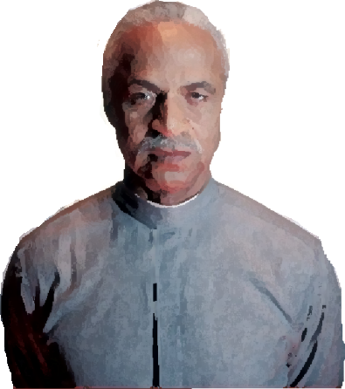
My role is …
Notes:
Since people see me as being the “accessibility person,” then I had to face the fact that they look to me for guidance in all areas of accessibility. They even expect that for products we don’t own or support.
Sometimes an accessibility consultant has to be a counselor, mediator, evangelist, educator, and a maverick (among other roles).

Slide 54
Now, back to you …
Notes:
How are you considering accessibility for higher ed websites? Older students; students with disabilities; students who aren't native English speakers?
How can you apply a similar approach and process?
Consider what is appropriate given your project’s size, frequency of updates, your workload.

Slide 55
Don’t panic
If you don't have experience in an area of accessibility, someone is always willing to talk with your group and teach them. Arrange a brown bag or a webinar.
Host a hackathon: Invite people from inside and outside your organization to work together to fix your top accessibility barriers.
Organize a campus/local accessibility group.

Slide 56
Bridge the gap between people, departments, and philosophies.
Notes:
Organize team-building activities. Combat rivalries by sharing what you have in common. Have brown bag lunch events where you talk about a particular topic—work related or not. Make sure everyone who wants to talk is heard, whether or not you agree with them.
If people see you as being the “accessibility person,” then you have to face the fact that they look to you for guidance in all areas of accessibility.
Sometimes an accessibility consultant has to be a counselor, evangelist, educator, and a maverick (among other roles).

Slide 57
Final thoughts
Start small.
One person may have many roles.
Adapt this to your organization and its culture—keep it evolving.
Build rapport within and among teams—talk.
Negotiate—don’t get intimidated.
It’s about what’s best for people (your audience).

Slide 58
(Remember, Jayne wasn’t annoying because he didn’t understand accessibility.)
Notes:
He called me at 6 AM!
He called me “Angie”!
We don’t walk on water, and too often, people view accessibility folks as being know-it-alls who look down on others for not understanding accessibility—and treating them like idiots.
Be patient with the Jaynes of the world, and be willing to educate and edify your team members.

Slide 59
Resources

Slide 60
Sample process
Tailor this to your needs and to each project.
Document this entire process.
Choose who should work on the project, and assign tasks/roles to everyone according to their skills and strengths.
Plan/gather requirements with the decision makers, stakeholders, designers, developers, content providers, etc.

Slide 61
Sample process
Determine which standards and guidelines are appropriate for your project (WCAG 2.0, Mobile Best Practices, ATAG, CVAA, iOS Accessibility Standards, etc.).
Put accessibility requirements in any vendor requests for proposals and/or contracts.
Determine your users’ top tasks.

Slide 62
Sample process
Review the information architecture.
Analyze the resulting wireframes.
Conduct usability testing with paper prototypes (wireframes).
Choose and test the color scheme.
Assess the design mockups.
Review the final written content.

Slide 63
Sample process
Conduct more informal user testing (test the mockups, writing, information architecture).
Review the templates (including ARIA); validate/remediate the (semantic) code.
Just because your code validates doesn’t mean your project is accessible—validate anyway!
Just because your site doesn’t validate doesn’t mean it’s inaccessible—validate anyway!

Slide 64
Sample process
Review the style sheets; validate/remediate the styles.
Test with automated accessibility tools.
Review the scripting (JavaScript, AJAX, jQuery, YUI, whatever); add more ARIA, if needed.
Test again with automated tools.

Slide 65
Sample process
Test with assistive technologies.
Test on mobile devices and e-readers.
Test with real people, including several people with different disability types—don’t forget to test the written content, too.
Continue to improve and test after the launch (since browsers and software change).

Slide 66
WCAG 2.0 and general *a11y
Government of Canada Web Experience Toolkit (WET)—above all else, see the Accessibility Responsibilities Breakdown; it will help you create your process and define roles.
Constructing a POUR Website, WebAIM
BBC’s Future Media Standards and Guidelines
A11y Buzz
* accessibility

Slide 67
Disabilities
Disability types/issues
Visual, cognitive, motor, and hearing impairments; neurological/seizure disorders; elderly and aging
What Is Assistive Technology? – ATIA
Videos of people using assistive technologies, from AssistiveWare
How Assistive Technology Works (demonstrations), University of Dundee

Slide 68
Project management
Integrating Accessibility in the Organization’s Web Development Life Cycle, Denis Boudreau
Accessibility for Project Managers, Henny Swan
Managing Accessibility Compliance in the Enterprise, Karl Groves
Plan for Accessibility, Option Keys

Slide 69
Project management
Planning Accessibility, Government of Canada
Just Ask: Integrating Accessibility Throughout Design, Shawn Lawton Henry

Slide 70
Writing content
Accessibility for Web Writers, by 4 Syllables
Content and Usability: Web Writing, Web Credible
Make it Plain: Accessibility and Usability Through Plain Language, Angela Hooker (hey!)
Plain Language: Accessibility for Information, Whitney Quesenbery
Plain Language Checklist, PlainLanguage.gov

Slide 71
Design
Web Accessibility for Designers, WebAIM
Just Ask: Integrating Accessibility Throughout Design, Shawn Lawton Henry
Design Considerations, WebAIM
Color Contrast Checker, WebAIM
Accessibility Color Wheel
Trace Photosensitive Epilepsy Analysis Tool (PEAT) – tests flashing content

Slide 72
Development
Web Accessibility for Developers (videos), BBC
Build a code library!
Use code generators (see Accessify’s tools).
Web Developer Toolbar, Chris Pederick
Firebug, Mozilla
WCAG 2.0 Checklist, WebAIM
Web Accessibility Gone Wild, WebAIM

Slide 73
Development
W3C Mobile Web Best Practices
Juicy Studio Accessibility Toolbar —for ARIA, data tables, color contrast
aChecker, Inclusive Design Institute at OCAD University
WAVE Toolbar, WebAIM
Favelets for Checking Web Accessibility, Jim Thatcher

Slide 74
Quality assurance
Template for Accessibility Evaluation Reports, W3C-WAI
Accessibility Evaluation Resources, W3C-Web Accessibility Initiative
Evaluation, Testing, and Tools, WebAIM
WCAG 2.0 Checklist, WebAIM
Wickline Color Blind Web Page Filter
Web Developer Toolbar, Chris Pederick

Slide 75
Quality assurance
Firebug, Mozilla
Favelets for Checking Web Accessibility, Jim Thatcher
Trace Photosensitive Epilepsy Analysis Tool (PEAT) – tests flashing content
Web Accessibility Initiative (WAI), Evaluating Websites for Accessibility

Slide 76
Quality assurance
Central Office of Information (COI), Delivering Inclusive Websites
Establishing a Screen Reader Test Plan, Henny Swan
How to Use NVDA and Firefox to Test for Accessibility, Marco Zehe
Web Accessibility Gone Wild, WebAIM

Slide 77
Usability
Usability Testing and Conducting Usability Testing, Just Ask: Integrating Accessibility Throughout Design, Shawn Lawton-Henry
Usability Testing for People with Disabilities, Kathy Wahlbin and Mary Hunter Utt
Steve Krug, Rocket Surgery Made Easy

Slide 78
Thank you!
Angela Hooker
@AccessForAll
ange@angelahooker.com
angelahooker.com

